Slide 1
36118 Applied Natural Language Processing (ANLP)
Master of Data Science and Innovation
Session 9
28/09/2026
Mutaz Abu Ghazaleh
Senior Lecturer, MDSI
Notes:
https://handbook.uts.edu.au/subjects/36118.html

Slide 2



Before We Kick Off... 📋
Side Chats
Phones
Sliding Doors
Please, minimise side conversations 🙊
Please turn sound off 📵
Use the sliding doors 🚪
Let’s respect each other’s time and learning 🙏

Slide 3
Today’s session
1
From RAG to agents: workflow control and agent loops
2
Workflow patterns and reliable tool design
3
Core lab: notebooks 01 and 02
4
MCP and the multi-agent framework ecosystem
5
Tracing, guardrails, and human approval
6
Optional extensions: Gradio, Ollama, and MLflow
7
Agent design activity and review

Slide 4
From LLMs to AI Agents

Slide 5
Setup your env
Public course repository: github.com/mdsiprojects/anlpspr2026-published
From the repository root, activate the Python 3.12 .venv and install requirements.txt.
Create a local .env file with OPENAI_API_KEY.
Optional configuration: OPENAI_ORG_ID and OPENAI_PROJECT_ID.
Set OPENAI_MODEL when needed; the teaching default is gpt-5.6-luna.

Slide 6
Course Notebooks: Session 9 Overview
Notebook | What you will build
CORE 01_agents_concepts | Agentic RAG, workflow patterns, and MCPServer
CORE 02_agent_with_tools | Tools, tracing, agents as tools, and handoffs
OPTIONAL 03_beyond_basics | Streaming, state, hooks, and typed output
OPTIONAL 04_agent_gradio_app | Gradio interface with a human approval checkpoint

Slide 7

AI Agents

Slide 8

… What is an AI Agent?

Slide 9
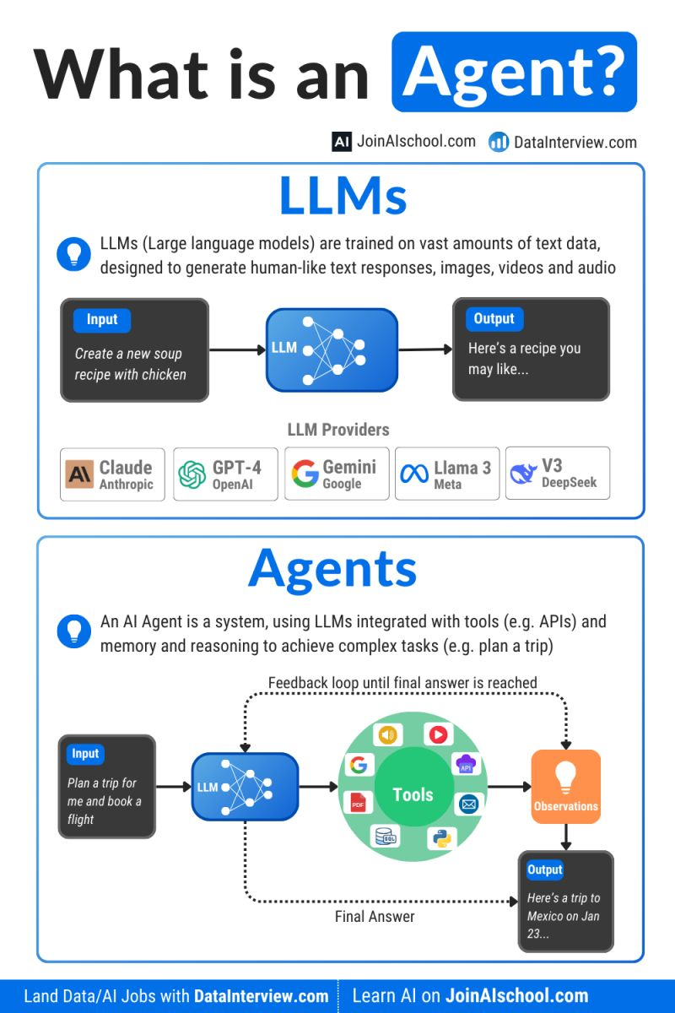
LLM vs Agent

Slide 10
Yesterday
Today
Tomorrow
User
User
User
Legal Agent
HR Agent
Agent/Chatbot
Single Agent
Product Agent
Collaboration
Marketing Agent
Human Supervisor
Procurement Agent
Human Supervisor
Able to answer questions
Able to take actions
Able to collaboratively solve complex tasks
“Order a laptop for
a new employee”
“What is the dress code?”
“Do everything needed to onboard 5 employees by Monday”

Slide 11
Building with the OpenAI Agents SDK

Slide 12
The OpenAI Agents SDK
A framework for building LLMs that act, not just respond
The core idea: A single LLM call answers a question. An agent takes a goal, decides what to do, uses tools to act on the world, observes results, and keeps going until the job is done.
The OpenAI Agents SDK is a lightweight Python framework that wires this loop together with production-grade primitives.
The five building blocks:
Primitive | What it is | In code
Agent | LLM + instructions + tools | Agent(name=..., instructions=..., tools=[...])
Tool | Python function the agent can call | @function_tool decorator
Handoff | Agent delegates to a specialist | handoff(specialist_agent)
Guardrail | Parallel validation on input/output | InputGuardrail(guardrail_function)
Runner | Executes the agent loop | await Runner.run(agent, input)
Why it matters: You write normal Python functions. The SDK handles the LLM loop, tool dispatch, result injection, and tracing automatically.
Notes:
Source: OpenAI Agents SDK documentation, https://openai.github.io/openai-agents-python/ (accessed 16 September 2026).

Slide 13
How an Agent Run Works
The reasoning loop, step by step
Conceptually: the agent reasons, acts, observes, and repeats, until done.
Three execution modes:
You: "Summarise the latest RAG research and email it to the team"
# Async — recommended for production
result = await Runner.run(agent, "your input")
# Synchronous — for scripts and notebooks
result = Runner.run_sync(agent, "your input")
# Streaming — see tokens and tool calls in real time
async for event in Runner.run_streamed(agent, "your input"):
...
Agent receives: goal + system prompt + available tools
LLM reasons: "I need to search first"
Tool call → search(query="RAG research 2025") → results returned
LLM reasons: "Now I can summarise, then email"
Guardrails run in parallel — zero latency on the happy path. If a rule is violated, a GuardrailTripwireTriggered exception is raised and the run stops immediately.
Tool call → send_email(body=summary) → done
LLM produces final response: "Done — email sent"
Tracing is automatic — every run, tool call, handoff, and guardrail check is logged. View in the OpenAI dashboard or export to your own observability stack.

Slide 14
Agentic RAG

Slide 15
The Agentic RAG Loop
1. User asks a question
2. Agent formulates a search query
3. Agent calls retrieval tool (e.g., FAISS vector search)
4. Agent evaluates results — enough context?
5. Yes → generate final answer
6. No → refine query, go to step 3
This is the bridge from Session 8 (RAG) to Session 9 (Agents)
In notebook 02, you will build this with the OpenAI Agents SDK
Hands-on: 02_agent_with_tools.ipynb, Section 4

Slide 16
Tools and Agents
Tools are function calling for Agents.
Tools enable agents to perform various actions, such as retrieving data, executing code, accessing external APIs, and utilizing computer resources.
Frameworks offer built in tools such as Web and Files Search.
You can also define your own functions as tools to be executed with Agents.
Agents simplify and abstract the execution of tools when compared to using function calling in LLMS.
__start__
Assistant
__end__
get_weather
get_current_time

Slide 17
Structured Output in the Agents SDK
output_type: tell the agent to return a Pydantic model instead of free text
The LLM always sees JSON Schema — Pydantic objects are Python-layer
Two places structured output appears:
  Tool return types — function_tool with type-hinted return
  Agent output_type — agent returns a typed object
class ResearchSummary(BaseModel):
topic: str
key_findings: list[str]
researcher = Agent(output_type=ResearchSummary, ...)
result.final_output # → ResearchSummary instance, not a string
Hands-on: 02_agent_with_tools.ipynb, Sections 3 and 5

Slide 18
Tracing & Observability

Slide 19
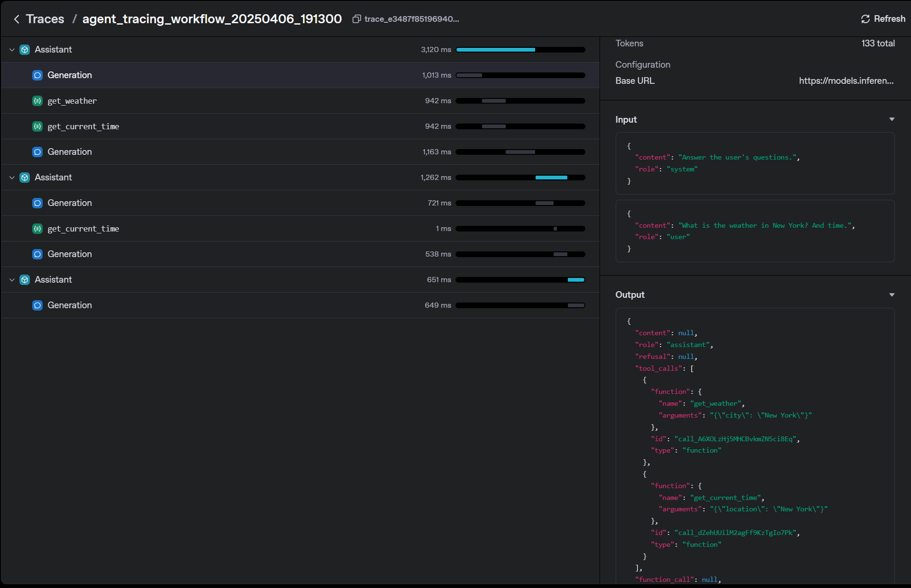
Observability: Tracing Agent Execution
Tracing provides several important benefits for AI agent development and operation:
Debugging and Troubleshooting: Trace the execution path of agents to identify issues in complex workflows
Performance Monitoring: Track latency, token usage, and other metrics to optimize agent performance
Transparency: Gain visibility into how agents make decisions and use tools
Auditability: Create records of agent activities for compliance and governance purposes
User Experience Improvement: Analyse patterns in agent behaviour to improve prompts and tool designs

Slide 20
Production Tracing Patterns
Trace continuity: reuse trace_id across multiple Runner.run() calls
  All runs in a session appear as one workflow in the dashboard
Correlation IDs: human-readable identifier for support
  Generated per session (e.g., "A3F7B2C1")
  Embedded in workflow_name and trace_metadata
  Shown in the UI so users can quote it when contacting support
Pattern: gen_trace_id() from agents.tracing
run_cfg = RunConfig(trace_id=trace_id,
workflow_name=f"session_{correlation_id}",
trace_metadata={"correlation_id": correlation_id})
Hands-on: 04_agent_gradio_app.ipynb

Slide 21
Core lab: Agent foundations
Notebook | Objective
01_agents_concepts | Sections 1-2: Agentic RAG concepts, LLM vs Agent comparison
02_agent_with_tools | Sections 1-2: Hello Agent (simplest case), tracing and observability
02_agent_with_tools | Section 2 continued: Platform tracing, trace continuity, correlation IDs

Slide 22
Orchestrating Agents
Orchestration
  Agents as tools
  Handoffs
Recommendations and best practices:
  Good prompts
  Structured Output
  Context size and max tokens
  Specialised Agents
  Monitor the app
  Invest in evals
Notes:
Orchestrating multiple agents - OpenAI Agents SDK
https://openai.github.io/openai-agents-python/multi_agent/

Slide 23
Agent as a tool
__start__
orchestrator_agent
__end__
translate_to_spanish
translate_to_french
The tool agent goes off and runs on its own and then returns the result to the original agent.
When agents are used as tools, only the needed input data is passed on to the tool agent, not the entire context and message history. That’s a useful approach when agents do not require to take control of the workflow context.

Slide 24
Handoffs
Handoff delegates the task to another agent.
The full context and control is passed on to the new agent.
Notes:
Agent handoffs refer to the process by which one autonomous agent delegates a task to another agent within a multi-agent system. This capability is crucial for designing scalable and modular agentic architectures, where each agent encapsulates domain-specific logic or functionality. For example, in a customer support application, separate agents may be instantiated to manage tasks such as retrieving order status, handling refund requests, or resolving frequently asked questions. By leveraging specialization through handoffs, systems can improve task efficiency, maintain clearer responsibility boundaries, and support more sophisticated orchestration strategies.

Slide 25
Agent as Tools vs Handoffs
Handoffs:
  Great for sequential tasks and workflows.
  Pass entire context between agents.
  Easy to conceptualize linear agent flows.
Agents as Tools:
  Offer dynamic, conditional orchestration.
  Allow dynamic control of multiple specialized agents.
  Scalable and extensible.
It is expected to have to use both in creating agentic workflow.
__start__
weather_agent
weather_data_collector
whether_report_summariser_agent
__end__
When would you combine the two patterns?
Notes:
https://gabrielchua.me/posts/openai-agents-sdk-first-thoughts/

Slide 26
Core lab: Tools and handoffs (Notebook 02)
Notebook | Objective
02_agent_with_tools | Section 5: Orchestrator-Workers pattern using agents as tools
02_agent_with_tools | Section 6: Handoffs — permanently transferring control between agents

Slide 27
Agentic Workflow Patterns

Slide 28
Common Agentic Patterns
Reflection: The LLM examines its own work to come up with ways to improve it.
Tool Use: The LLM is given tools such as web search, code execution, or any other function to help it gather information, take action, or process data.
Planning: The LLM comes up with, and executes, a multistep plan to achieve a goal (for example, writing an outline for an essay, then doing online research, then writing a draft, and so on).
Multi-agent collaboration: More than one AI agent work together, splitting up tasks and discussing and debating ideas, to come up with better solutions than a single agent would.
Notes:
Andrew Ng Feb 2024
Four AI Agent Strategies That Improve GPT-4 and GPT-3.5 Performance
https://github.com/openai/openai-agents-python/tree/main/examples/agent_patterns

Slide 29
Workflow Pattern: Prompt Chaining
Decompose a task into a sequence of steps
Each LLM call processes the output of the previous one
Gate: each step can include validation before proceeding
e.g., check output quality before passing to next step
Example: generate outline → expand each section → polish prose
Best for: tasks with clear sequential dependencies
Trade-off: higher latency (sequential), but each step is simpler
See: 01_agents_concepts.ipynb, Section 3 — Pattern 1

Slide 30
Workflow Pattern: Routing
Classify input and direct it to a specialised handler
The LLM (or a simple classifier) acts as a router
Each route has its own prompt, tools, or model
Example: customer query → billing / technical / general
Each handler is optimised for its category
Best for: distinct categories requiring different approaches
Enables: cheaper models for simple routes, powerful models for complex ones
See: 01_agents_concepts.ipynb, Section 3 — Pattern 2

Slide 31
Workflow Pattern: Parallelisation
Run multiple LLM calls simultaneously, then aggregate results
Sectioning: split task into independent subtasks
e.g., evaluate essay on grammar, content, and style in parallel
Voting: run the same task multiple times, take majority or best
e.g., generate 3 translations, pick the best one
Best for: tasks decomposable into independent subtasks
Trade-off: higher cost (multiple calls), but much lower latency
See: 01_agents_concepts.ipynb, Section 3 — Pattern 3

Slide 32
Workflow Pattern: Evaluator-Optimiser
One LLM generates, another evaluates, loop until quality met
Similar to reflection, but with separate generator and evaluator
The evaluator provides specific, actionable feedback
Example: code generation → code review → fix issues → re-review
Best for: tasks with clear, measurable quality criteria
Key: evaluator feedback must be specific enough to guide improvement
See: 01_agents_concepts.ipynb, Section 3 — Pattern 4

Slide 33
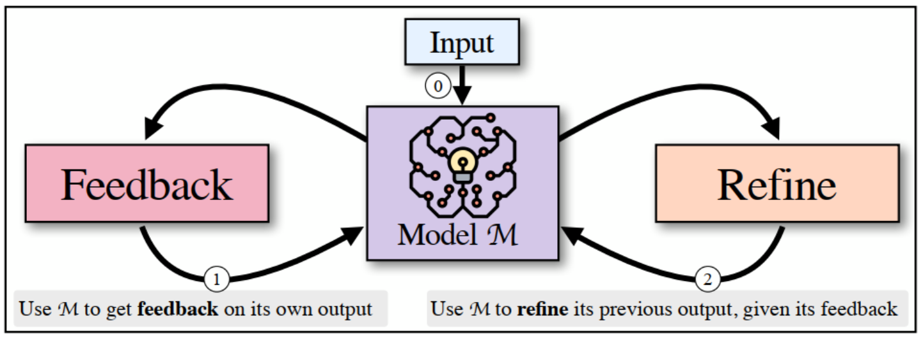
Reflection
Introduced in May 2023, SELF-REFINE (https://arxiv.org/pdf/2303.17651) is a method for enhancing initial outputs from large language models (LLMs) through a process of iterative feedback and refinement. The core idea involves generating an initial response using an LLM, then having the same LLM critique its own output and use that feedback to progressively improve the response over multiple iterations.
Notes:
Agentic Design Patterns Part 2: Reflection
https://www.deeplearning.ai/the-batch/agentic-design-patterns-part-2-reflection

Slide 34
Reflection (deterministic)
start
generator
Pass generated output to Evaluator
evaluator
rerun
Pass generated output to Evaluator
complete
code\03_beyond_basics.ipynb
end

Slide 35
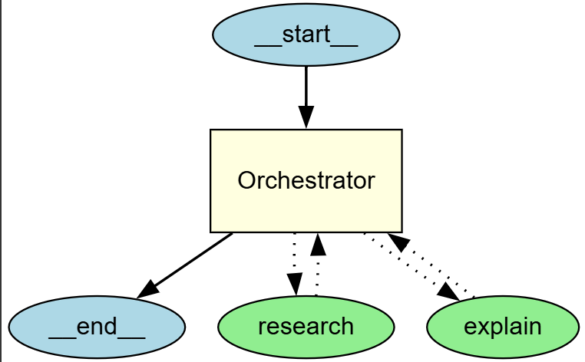
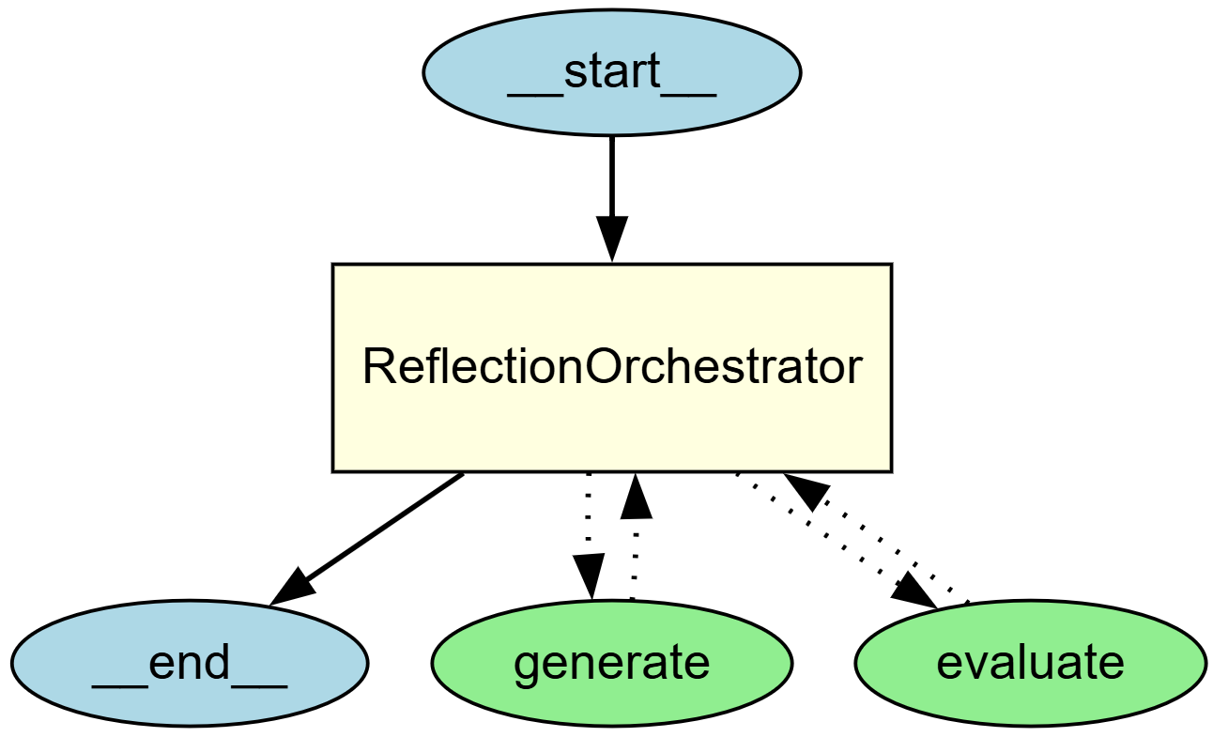
Reflection (as tools)

Slide 36
Core lab: Workflow patterns
Notebook | Objective
02_agent_with_tools 03_beyond_basics | NB02 S7: Reflection via tool descriptions NB03 S4: Deterministic vs stochastic orchestration
02_agent_with_tools | Section 5: Orchestrator-Workers pattern (planning via agent-as-tool)

Slide 37
Beyond the Basics: Real-World SDK Patterns
Notebook 03 covers patterns you will need in production:
1. Multi-turn Conversations
  result.to_input_list() appends agent output to message history
  Enables follow-up questions without losing context
2. State Management with context=
  Pass a shared Python object into every tool and hook
  Agent reads/writes state without polluting the message history
3. Lifecycle Hooks (RunHooks)
  on_agent_start / on_agent_end / on_tool_start
  Use for logging, circuit breakers, cost tracking
4. Deterministic vs Stochastic Orchestration
  Deterministic: Python code controls the flow
  Stochastic: LLM decides what tool to call next
Hands-on: 03_beyond_basics.ipynb

Slide 38
Streaming Agent Responses
Runner.run_streamed() yields events as the agent works
Event types:
RawResponsesStreamEvent — raw model output chunks
ResponseTextDeltaEvent — text delta for printing
RunItemStreamEvent — tool calls, tool results
Pattern: streaming REPL
streamed = Runner.run_streamed(agent, input)
async for event in streamed.stream_events():
if isinstance(event.data, ResponseTextDeltaEvent):
print(event.data.delta, end="", flush=True)
Used in the Gradio app (notebook 04) for real-time responses
Hands-on: 03_beyond_basics.ipynb (Section 1) + 04_agent_gradio_app.ipynb

Slide 39
Optional lab: Streaming and Gradio
Notebook 03: 03_beyond_basics.ipynb
Multi-turn state, deterministic streaming, lifecycle hooks, and typed output
Interactive REPL available as an opt-in classroom extension
Notebook 04: 04_agent_gradio_app.ipynb
Streaming Gradio chat interface
Human approval checkpoint before a consequential action
Session tracing with a correlation ID

Slide 40
Optional lab: Ollama and MLflow
Notebook 05: 05_ollama_model_switch.ipynb
Keep Agent and Runner; use OpenAIChatCompletionsModel.
Point it at Ollama; compare qwen3:4b with another local model.
MLflow records agent and model spans in a local SQLite database.
No OpenAI key or platform traces in the default path.
Notes:
Demo: open notebook 05 and run the same Agents SDK agent with local Ollama models.
The default path disables OpenAI trace export and records traces locally with MLflow. OpenAI export is opt-in.
Student notebook: https://github.com/mdsiprojects/anlpspr2026-published/blob/main/material/Session%209/notebooks/05_ollama_model_switch.ipynb
Sources: https://openai.github.io/openai-agents-python/models/
https://docs.ollama.com/api/openai-compatibility
https://mlflow.org/docs/latest/genai/tracing/integrations/listing/openai-agent/

Slide 41
Responsible Use Considerations?
Privacy, Security and Data Protection, specially as data traverses multiple systems and agents
Bias and Fairness, just as with all AI/ML systems, but now LLMs and Agentic is offering new opportunities to automate processes with higher levels of autonomy
Accountability and Transparency: as multiple agents converse and cooperate to produce a result; how do we establish clear accountability and transparency mechanisms.
Can users understand and trace the decision-making process of the agents involved to ensure accountability, transparency and mitigate biases?
Unintended Consequences: the use of multi-agent conversations and automation in complex tasks may have unintended consequences. In particular, allowing LLM agents to define execution plans or equip them with tools to make changes in external environments.
How do we assess the potential risks and ensure that appropriate safeguards are in place to prevent harm or negative outcomes?
Notes:
Discussion prompts:
How does the system protect private data and reduce biased outcomes?
Can users inspect important decisions and identify who is accountable?
Which actions need a human approval boundary?
How does the system contain unintended tool side effects?

Slide 42
Human-in-the-Loop

Slide 43
Human in the Loop
Pause an agent at decision boundaries that need judgement or authority.
OpenAI Agents SDK patterns
RunHooks record lifecycle events and support operational controls.
An approval tool returns a pending state before any consequential action.
The UI presents Approve and Reject choices, then resumes with the decision.
Gradio streams the response while keeping the approval boundary explicit.

Slide 44
HITL: Building an Approval UI with Gradio
Gradio chat interface with streaming agent responses
Approval flow:
  1. Agent receives user message, starts processing
  2. Agent calls a sensitive tool (e.g., enrol student)
  3. UI pauses and shows approval request with details
  4. User approves → tool executes, agent continues
  5. User rejects → agent aborts or takes alternative action
Session tracing:
  Correlation ID links UI session to OpenAI traces
  All messages in one session share a trace_id
  User can quote the Conversation ID for support
Hands-on: 04_agent_gradio_app.ipynb

Slide 45
Frameworks, MCP & the Ecosystem

Slide 46
Guardrails: Input and Output Safety
Guardrails run safety checks in parallel with agent execution
Input guardrails: validate user input before the agent sees it
e.g., detect prompt injection, off-topic queries, PII
Output guardrails: validate agent response before it reaches the user
e.g., check for harmful content, hallucinated facts, policy violations
Fail fast: guardrail raises GuardrailTripwireTriggered exception
Agent run is cancelled immediately — no partial output returned
Defined as classes with a run() method, attached to Agent()
agent = Agent(input_guardrails=[...], output_guardrails=[...])
See: OpenAI Agents SDK docs — Guardrails

Slide 47
Agent Frameworks Comparison (2026)
Framework | Steward | Language | Primary strength | Multi-agent | Protocols | Observability | Status
OpenAI Agents SDK | OpenAI | Python | Small set of agent primitives | Yes | MCP | Built-in tracing | Current
LangGraph | LangChain | Python / JS | Explicit durable graphs | Yes | MCP | LangSmith | Current
CrewAI | CrewAI | Python | Role-oriented teams | Yes | MCP | Built-in events | Current
Microsoft Agent Framework | Microsoft | Python / .NET | Enterprise agents and workflows | Yes | MCP / A2A | OpenTelemetry / Azure | 1.0 GA, Apr 2026
Google ADK | Google | Multi-language | Agents and A2A integration | Yes | MCP / A2A | Telemetry plugins | Current
Notes:
Sources:
OpenAI Agents SDK, https://openai.github.io/openai-agents-python/
Microsoft Agent Framework 1.0, https://devblogs.microsoft.com/agent-framework/microsoft-agent-framework-at-build-2026-announce/
Framework project documentation for LangGraph, CrewAI, and Google ADK (accessed 16 September 2026).

Slide 48
Interoperability protocols: MCP and A2A
Protocol | Connects | Course focus | Governance and status
MCP | AI applications with tools and context | Python SDK 2.x uses MCPServer | AAIF / Linux Foundation since Dec 2025
A2A | Agents with other agents | Discovery and cross-platform communication | Linux Foundation project with a broad vendor ecosystem
Notes:
Sources:
MCP Python SDK v2, https://github.com/modelcontextprotocol/python-sdk
MCP donation to AAIF, https://www.anthropic.com/news/donating-the-model-context-protocol-and-establishing-of-the-agentic-ai-foundation
A2A project, https://a2a-protocol.org/ (accessed 16 September 2026).

Slide 49
Choosing a Framework
Match the framework to the control model and operating environment
Single agent with tools: OpenAI Agents SDK or Google ADK
Explicit durable workflow: LangGraph
Role-oriented agent team: CrewAI
Enterprise Python or .NET: Microsoft Agent Framework 1.0
Decision factors
Workflow control, state, deployment, and data boundaries
Interoperability, tracing, evaluation, and approval support
Notes:
Framework selection is a design guide for this course, not a benchmark ranking. See the official framework documentation linked on the following slide.

Slide 50
Further Reading & Resources
OpenAI Agents SDK
Docs openai.github.io/openai-agents-python/
GitHub github.com/openai/openai-agents-python
Agent Frameworks
Google ADK google.github.io/adk-docs
AWS Strands strandsagents.com
LangGraph langchain-ai.github.io/langgraph/
CrewAI docs.crewai.com
Microsoft Agent Framework
learn.microsoft.com/agent-framework/
Interoperability protocols
MCP modelcontextprotocol.io
A2A a2a-protocol.org
Research and patterns
SELF-REFINE arxiv.org/abs/2303.17651
Anthropic anthropic.com/engineering/building-effective-agents
Notes:
All links checked against their official project documentation on 16 September 2026.

Slide 51
Design Practices
What is the process
Reduce the cognitive load of the LLM
  Deterministic steps and dynamic steps
Design and product thinking
  Personas
  User interactions
  Data
  Instructions

Slide 52
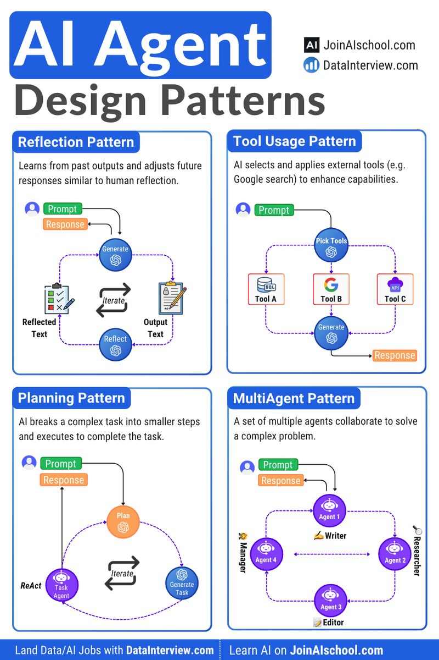
Design patterns
Notes:
Andrew Ng Feb 2024
Four AI Agent Strategies That Improve GPT-4 and GPT-3.5 Performance

Slide 53
Design your agents
Agent
Persona
Data sources
Tools/functions
What is your agent called?
How should the agent behave? What is its system message?
What data does this agent have available to it? For example, unstructured data in a vector DB, structured data in a NoSQL or SQL DB, or other APIs and files.
What tools and functions will the agent need to call?
Draw your AI agent’s avatar below
How would you describe the agent, so it is discoverable by other agents?
What team or business unit would this agent be aligned to? Who would directly interact with and maintain this agent?

Slide 54
Session 9 Summary
From RAG to agents
Agents let the model select tools and control the next step.
Deterministic workflows remain the better choice when the path is known.
Core implementation
Notebook 01: agentic RAG, workflow patterns, and MCPServer
Notebook 02: tools, tracing, agents as tools, and handoffs
Reliability boundaries
Clear tool contracts, tracing, guardrails, and human approval
MCP connects applications to tools. A2A connects agents to agents.
Optional extension
Notebooks 03–05 cover streaming, approval UI, Ollama, and MLflow tracing

